Slide 1


All Roads Lead to Rome
ODL BOOTCAMP Shenzhen 2016

Slide 2
Outline
3
Introduction
1
2
Architecture
3
Implementation
3
4
Summary

Slide 3
Introduction
Who we are?
  Fanka.Li from Tencent
  Jianwei.Mao from BUPT
  Feng.Liao from China Unicom
What we want to do?
  Path is chosen automatically
  Reduce highly utilized links
What we did?
  Topology visualization
  Network element collection
  optimum paths calculation

Slide 4
Outline
3
Introduction
1
2
Architecture
3
Implementation
3
4
Summary

Slide 5

Architecture
Load
Balance
Weight
REST API
Towards
easiness
ODL
Route
calculation
Topology
Manager
…
L2
Switch
Data
Store
Statistic
Manager
…
Topology
Manager
element collection
Service Abstraction Layer (SAL)
ODL
Mininet
OpenFlow13
REST API
Function call

Slide 6
Outline
3
Introduction
1
2
Architecture
3
Implementation
3
4
Summary

Slide 7
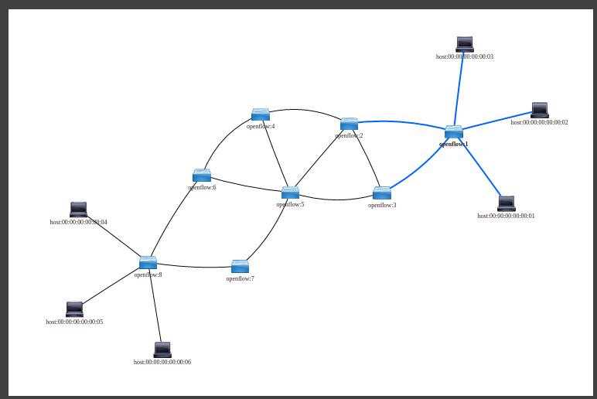
Topology Manager
Retrieve topology data and render it.
Retrieve statistic data and display it on the link.

Slide 8
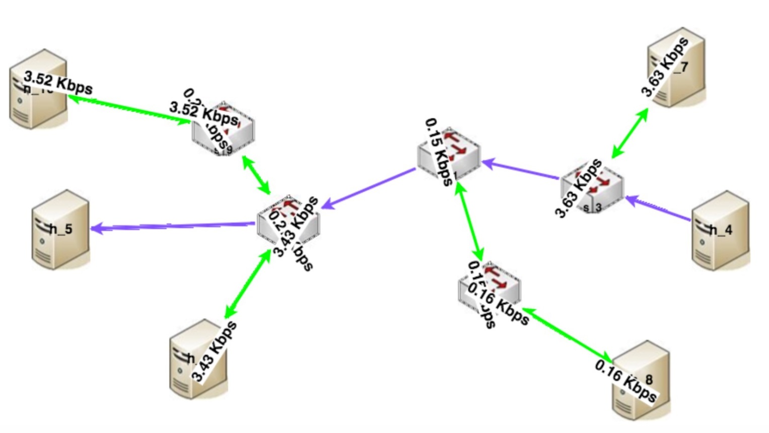
optimum route calculation
Calculate optimum route based on link loading and cost
Render and highlight the route

Slide 9
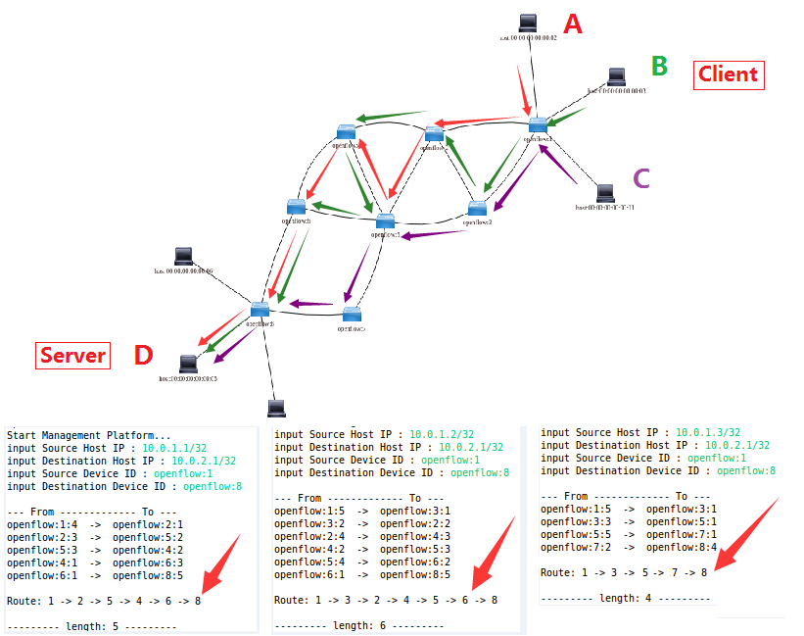


Slide 10
Outline
3
Introduction
1
2
Architecture
3
Implementation
3
4
Summary

Slide 11
Summary
With incorporation of Bootcamp learning, we realized an app based on ODL, which tries to choose path automatically.
For the app, it realizes topology visualization plus link loading, and supports optimum path calculation.
Besides, it supports network element management functionalities, ex. add/remove switch, host or link.
2 api docs, 1 operational doc and 1 introduction slides generated.
We used black-box testing to verify it.

Slide 12

Any
Questions

